Slide 1
FUNDAMENTAL of ALGORITHM
Lecturer: Saroj Poudel
Qualification: Ms CIS&IT, BE(Software)
Lincoln University College

Slide 2


Overview
Selection sort analysis
Divide and conquer strategy
Quick and Merge sort
Heap Sorting

Slide 3
Objectives
Understanding and analyze sorting algorithm
To learn how to use sorting techniques

Slide 4
sorting
Sorting refers to arranging data in a particular format(ascending/descending). Sorting algorithm specifies the way to arrange data in a particular order. Most common orders are in numerical or lexicographical(alphabetical) order.
A sorting algorithm is just a series of orders or instructions. In this, an array is an input, on which the sorting algorithm performs operations to give out a sorted array.
The importance of sorting lies in the fact that data searching can be optimized to a very high level, if data is stored in a sorted manner. Sorting is also used to represent data in more readable formats. Following are some of the examples of sorting in real-life scenarios −
Telephone Directory − The telephone directory stores the telephone numbers of people sorted by their names, so that the names can be searched easily.
Dictionary − The dictionary stores words in an alphabetical order so that searching of any word becomes easy.

Slide 5
Type of sorting
There are two different categories in sorting:
Internal sorting: If the input data is such that it can be adjusted in the main memory at once, it is called internal sorting.
External sorting: If the input data is such that it cannot be adjusted in the memory entirely at once, it needs to be stored in a hard disk, floppy disk, or any other storage device. This is called external sorting.

Slide 6
Selection Sort
The selection sort is a straightforward process of sorting values.
In this method, to sort the data in ascending order, the 0th element is compared with all other elements.
If the 0th element is found to be greater than the compared element, the two values get interchanged.
In this way after the first iteration, the smallest element is placed at 0th position.
The technique is repeated until the full array gets sorted.

Slide 7
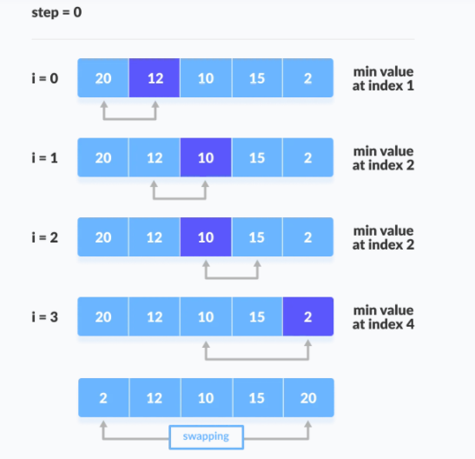

Slide 8
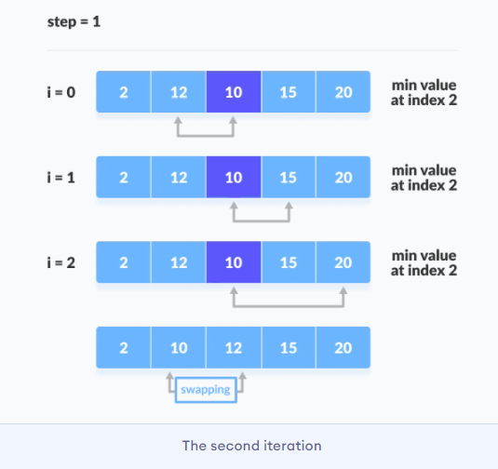

Slide 9
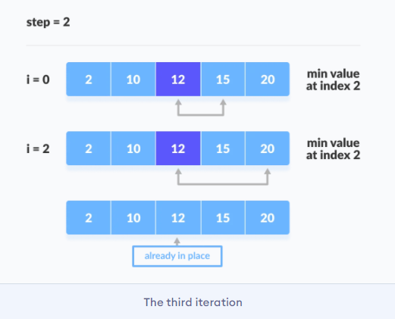

Slide 10
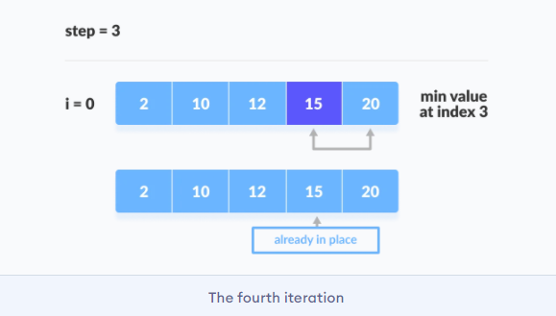

Slide 11
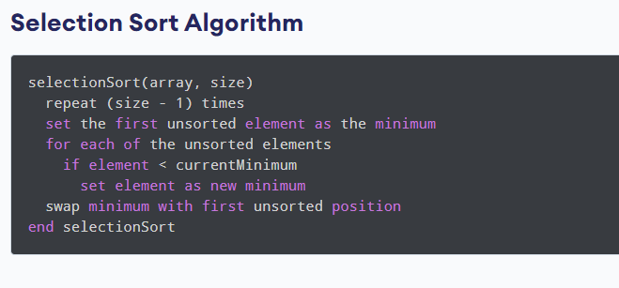

Slide 12
// C program for implementation of selection sort
#include <stdio.h>
void selectionSort(int arr[], int n)
{
int i, j, min_idx, temp;
for (i = 0; i < n-1; i++)
{
min_idx = i;
for (j = i+1; j < n; j++){
if (arr[j] < arr[min_idx])
min_idx = j;
// Swap the found minimum element with the first element
temp = arr[i];
arr[i] = arr[min_idx];
arr[min_idx] = temp;
}
}
int main()
{
int arr[] = {2,7,4,1,5,3};
selectionSort(arr, 6);
for (int i=o; i<6; i++){
print(“%d”, arr[i])
}
return 0;
}

Slide 13
Divide And Conquer Algorithm : Merge Sorting
A divide and conquer algorithm is a strategy of solving a large problem by:
breaking the problem into smaller sub-problems
solving the sub-problems, and
combining them to get the desired output.
The divide-and-conquer technique is the basis of efficient algorithms for many problems, such as sorting (e.g., quicksort, merge sort)

Slide 14
Merge Sorting
Merge sort is a sorting technique based on divide and conquer technique. With worst-case time complexity being Ο(n log n), it is one of the most respected algorithms.
Merge sort first divides the array into equal halves and then combines them in a sorted manner
Algorithm
Divide the unsorted list into sub-lists, each containing element.
Take adjacent pairs of two singleton lists and merge them to form a list of 2 elements. N. will now convert into lists of size 2.
Repeat the process till a single sorted list of obtained

Slide 15
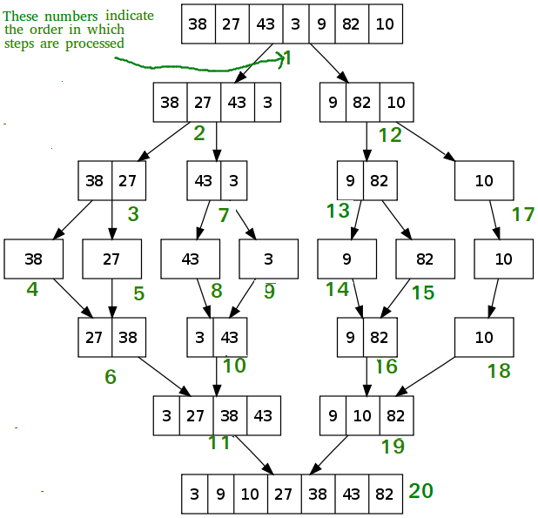

Slide 16
Merge Sort Analysis
whenever we divide a number into half in every step, it can be represented using a logarithmic function, which is log n and the number of steps can be represented by log n + 1(at most).
And to merge the subarrays, made by dividing the original array of n elements, a running time of O(n) will be required.
Hence the total time for mergeSort function will become n(log n + 1),
which gives us a time complexity of O(n*log n).

Slide 17
Quick Sort
An array is divided into subarrays by selecting a pivot element (element selected from the array).
While dividing the array, the pivot element should be positioned in such a way that elements less than pivot are kept on the left side and elements greater than pivot are on the right side of the pivot.
The left and right subarrays are also divided using the same approach. This process continues until each subarray contains a single element.
At this point, elements are already sorted. Finally, elements are combined to form a sorted array.

Slide 18
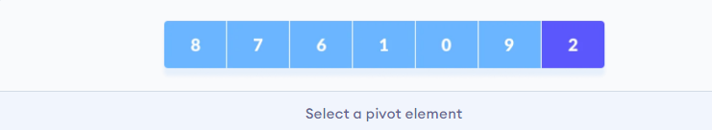
Working of Quicksort Algorithm
Select the Pivot Element
There are different variations of quicksort where the pivot element is selected from different positions. Here, we will be selecting the rightmost element of the array as the pivot element.

Slide 19
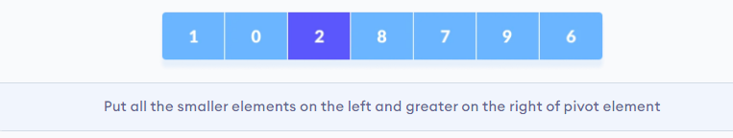
2. Rearrange the array
Now the elements of the array are rearranged so that elements that are smaller than the pivot are put on the left and the elements greater than the pivot are put on the right.

Slide 20
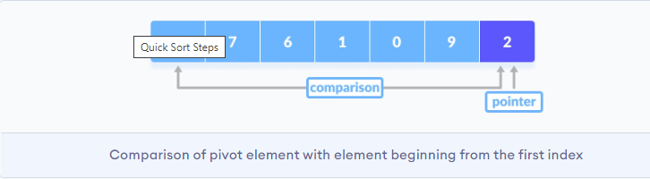
Here's how we rearrange the array:
A pointer is fixed at the pivot element. The pivot element is compared with the elements beginning from the first index.

Slide 21
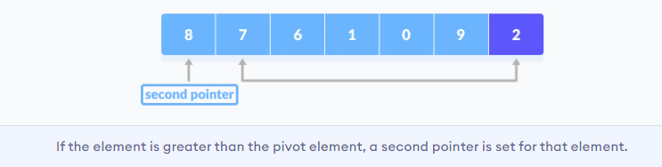
If the element is greater than the pivot element, a second pointer is set for that element.

Slide 22
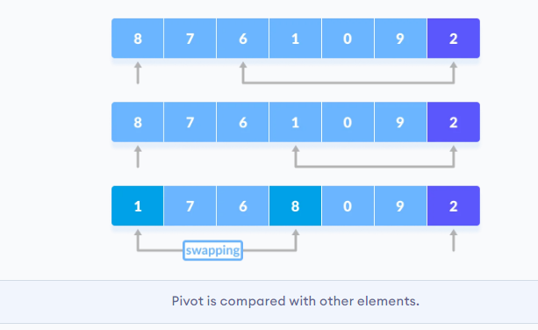
Now, pivot is compared with other elements. If an element smaller than the pivot element is reached, the smaller element is swapped with the greater element found earlier.

Slide 23
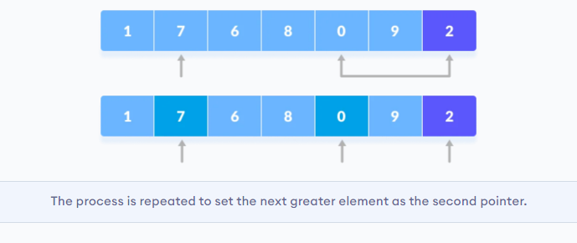
Again, the process is repeated to set the next greater element as the second pointer. And, swap it with another smaller element.

Slide 24
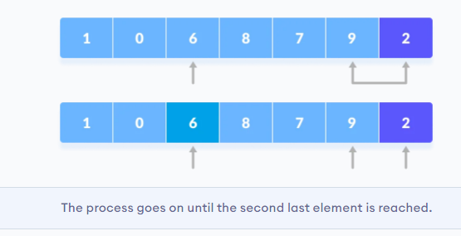
The process goes on until the second last element is reached.

Slide 25
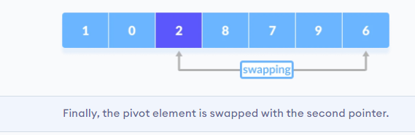
Finally, the pivot element is swapped with the second pointer.

Slide 26
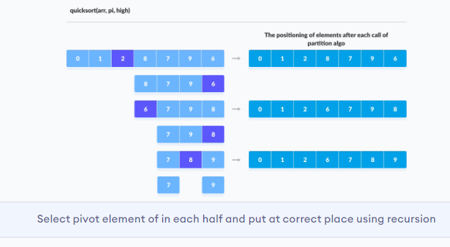
3. Divide subarrays
Pivot elements are again chosen for the left and the right sub-parts separately. And, step 2 is repeated.

Slide 27
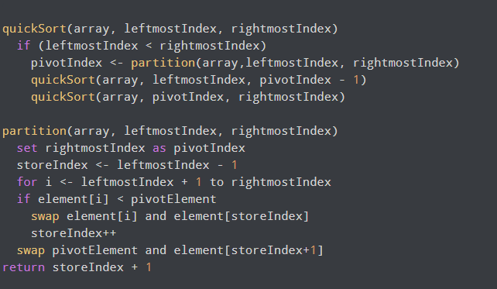
Quick Sort Algorithm

Slide 28
Time Complexities
Worst Case Complexity [Big-O]: O(n^2)
It occurs when the pivot element picked is either the greatest or the smallest element.
This condition leads to the case in which the pivot element lies in an extreme end of the sorted array. One sub-array is always empty and another sub-array contains n - 1 elements. Thus, quicksort is called only on this sub-array.
However, the quicksort algorithm has better performance for scattered pivots.
Best Case Complexity [Big-omega]: O(n*log n)
It occurs when the pivot element is always the middle element or near to the middle element.
Average Case Complexity [Big-theta]: O(n*log n)
It occurs when the above conditions do not occur.

Slide 32
Further Readings
Brian W. Kernighan and Dennis M. Ritchie, The C Programming Language, Prentice Hall, 1988.
Data Structures and Algorithms; Shi-Kuo Chang; World Scientifi c.
Data Structures and Effi cient Algorithms, Burkhard Monien, Thomas Ottmann, Springer.
Kruse Data Structure & Program Design, Prentice Hall of India, New Delhi
Mark Allen Weles: Data Structure & Algorithm Analysis in C Second Adition. Addison-Wesley publishing
RG Dromey, How to Solve it by Computer, Cambridge University Press.
Shi-kuo Chang, Data Structures and Algorithms, World Scientifi c
Sorenson and Tremblay: An Introduction to Data Structure with Algorithms.
Thomas H. Cormen, Charles E, Leiserson & Ronald L. Rivest: Introduction to Algorithms.
Prentice-Hall of India Pvt. Limited, New Delhi Timothy A. Budd, Classic Data Structures in C++, Addison Wesley

